Slide 1
Explosives Safety and Munitions Risk Management (ESMRM)
Mr Kane LEAR, ESMRM SO
Munitions Safety Information Analysis Centre (MSIAC), NATO HQ
K.Lear@msiac.nato.int
NATO UNCLASSIFIED
Notes:
Quick intro…

Slide 2
Why is ESMRM Important?
Notes:
Beirut Explosion August 4, 2020 (6 sec video)

Slide 3
Port of Beirut:
Approximately 2,750 metric tons of Ammonium Nitrate
Stored in a Hangar (warehouse) at the Port for >6years
Senior leaders were aware of risk and took no action
Ammonium Nitrate was decomposing and off-gassing
A fire started and approximately 15-minutes later there was an explosion
Blast was felt over 240km away in Cyprus
Registered a 3.3 magnitude earthquake on the Richter Scale
>200 dead
>6500 people injured
>300,000 people displaced from their residence
>13bn EUR in infrastructure damage
Notes:
According to the Lebanese government, the source of the explosion was 2,750 tons of ammonium nitrate, an explosive chemical often used as fertilizer and sometimes in bombs, which had been stored in the port warehouse after being confiscated from an abandoned Russian-owned ship in 2014.
The massive explosion in Beirut’s port shattered windows more than a mile away and sent a plume of smoke and debris soaring above the city’s tallest buildings. The blast was felt at least 150 miles away in Cyprus. It killed at least 200 people, injured at least 6500 and left dozens missing. Some 300,000 other people have been displaced from their homes.

Slide 4
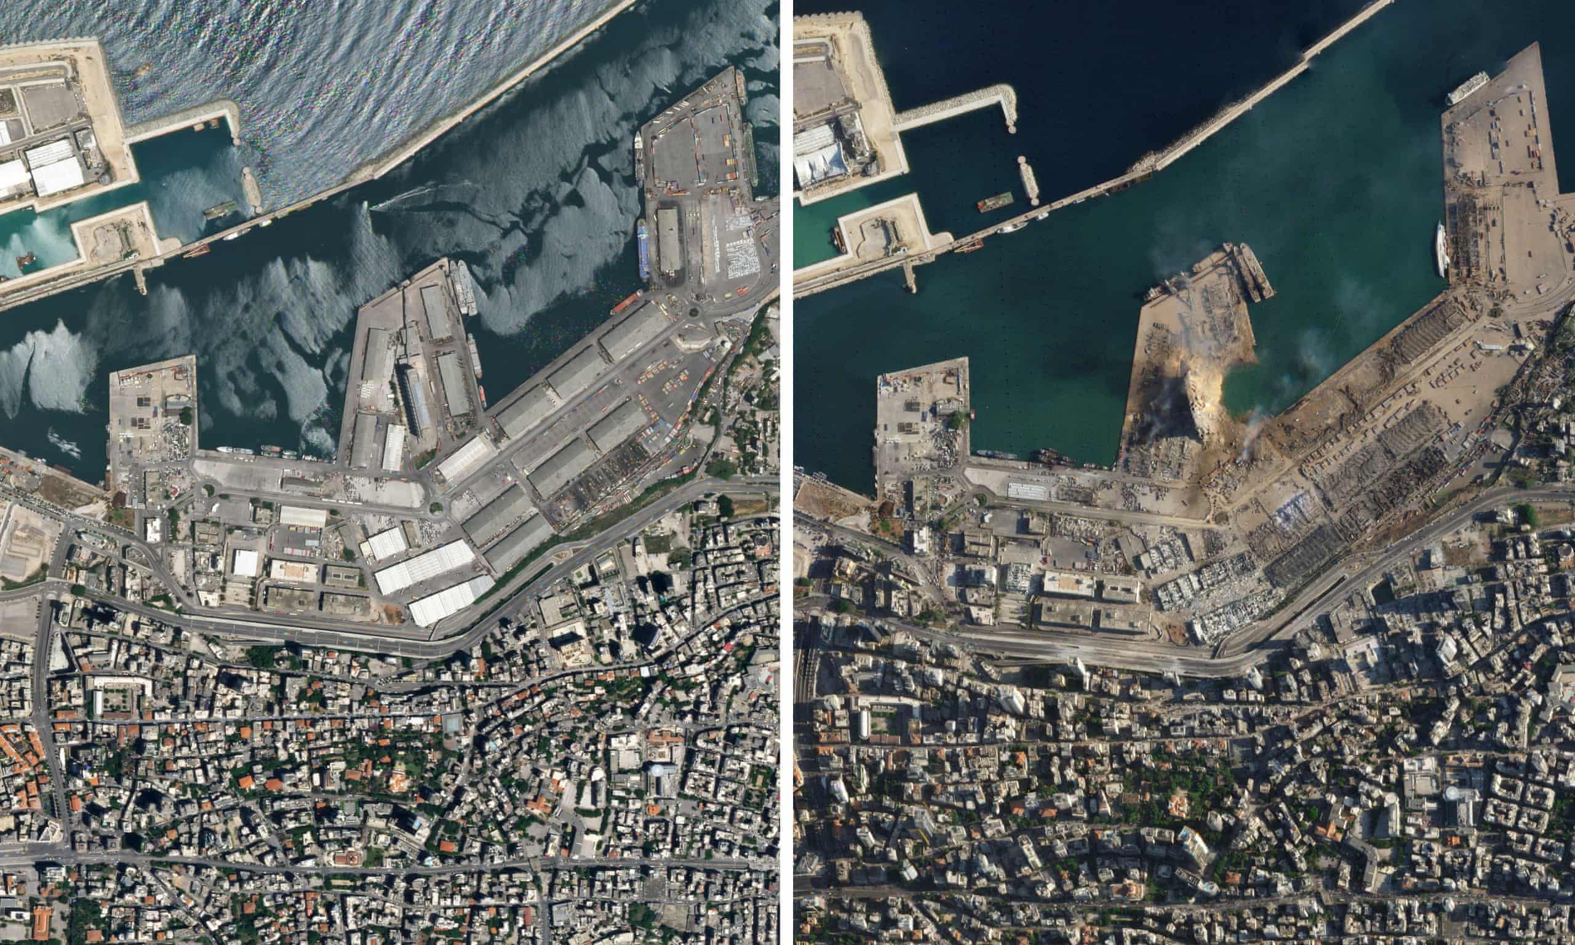
Port of Beirut
Notes:
Satellite images taken one day later show the scale of the explosion and confirm its exact location, a warehouse next to the Beirut Port grain silos. Only a gaping hole filled with water, approximately 460 feet in diameter, is left where the warehouse stood.
The images show how the explosion destroyed or damaged most structures in the port, over an area of about 160 acres. The explosion was so intense that it capsized a large ship, 1,500 feet to its east. The 390-foot-long passenger ship, Orient Queen, can be seen flipped to its side.

Slide 5
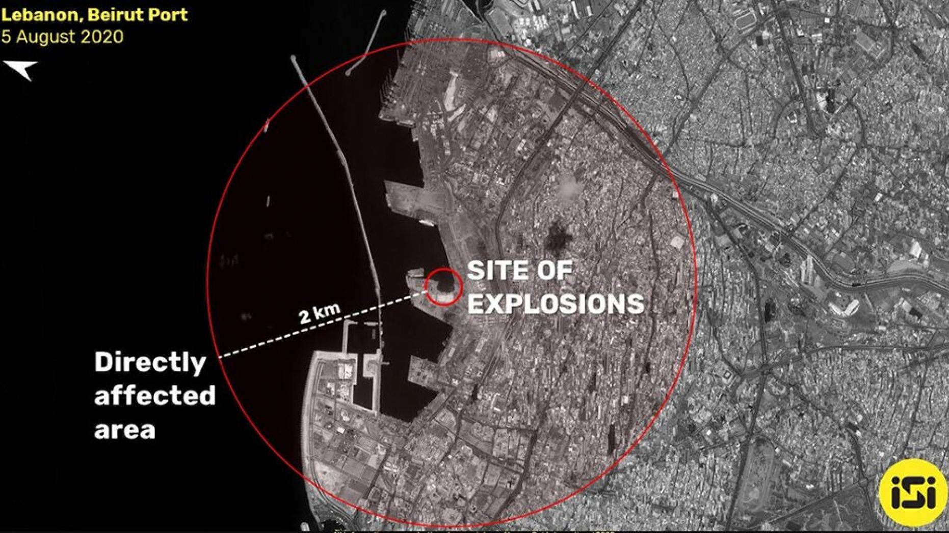
Port of Beirut
Notes:
Beirut’s port is centrally located, and thousands of people live in residential neighborhoods along the seaside within a mile of the blast. Videos showed the pressure wave flattening cars and speeding destructively through churches, mosques, apartments and shopping malls, including the Beirut Souks, which opened in 2009 after being rebuilt following the civil war.

Slide 6
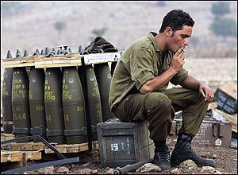
Explosives Safety
What publications regulate it?
ESMRM – what and why?
Who’s responsible?
Authority
Referral
Notes:
Discussion:
Was a Risk Assessment conducted?
What Risk was involved with this operation?
Who was responsible for accepting the Risk?
What’s the Mission Impact?
What could have been done to mitigate the mishap?

Slide 7
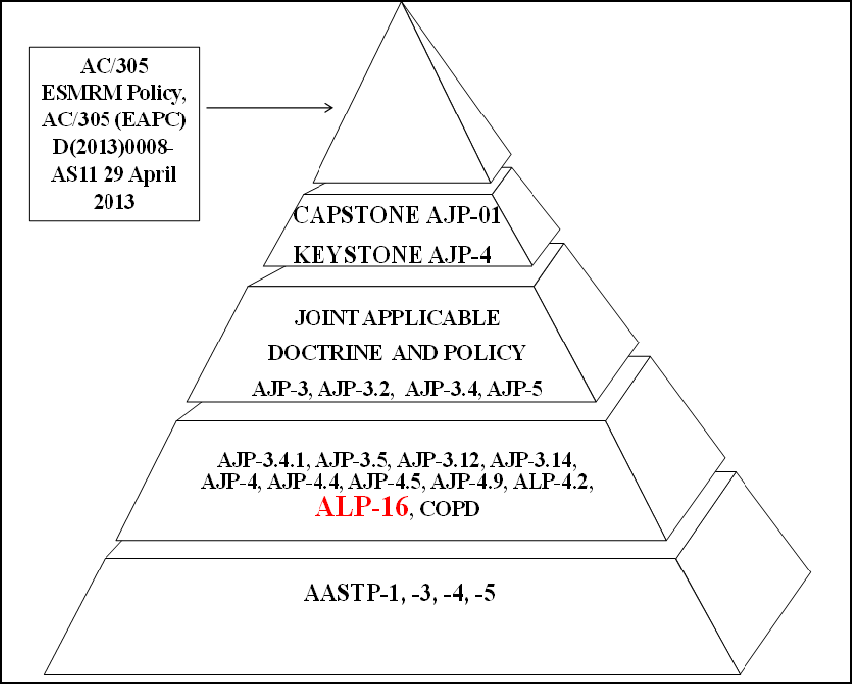
Explosives Safety - Regulations
Notes:
Discussion:
Was a Risk Assessment conducted?
What Risk was involved with this operation?
Who was responsible for accepting the Risk?
What’s the Mission Impact?
What could have been done to mitigate the mishap?

Slide 8
Explosives Safety - Regulations
NATO explosives safety requirements are contained in:
Allied Ammunition Storage and Transport Publication (AASTP)-1, “Manual of NATO Safety Principles for Storage of Military Ammunition and Explosives,”
AASTP-3, “Manual of NATO Safety Principles for the Hazard Classification of Military Ammunition and Explosives,”
AASTP-4, “Manual on the NATO Principles for the Application of Risk Analysis to the Storage and Transportation of Military Ammunition and Explosives,”
AASTP-5, “NATO Guidelines for the Storage, Maintenance and Transport of Ammunition on Deployed Missions or Operations
Notes:
Discussion:
Was a Risk Assessment conducted?
What Risk was involved with this operation?
Who was responsible for accepting the Risk?
What’s the Mission Impact?
What could have been done to mitigate the mishap?

Slide 9
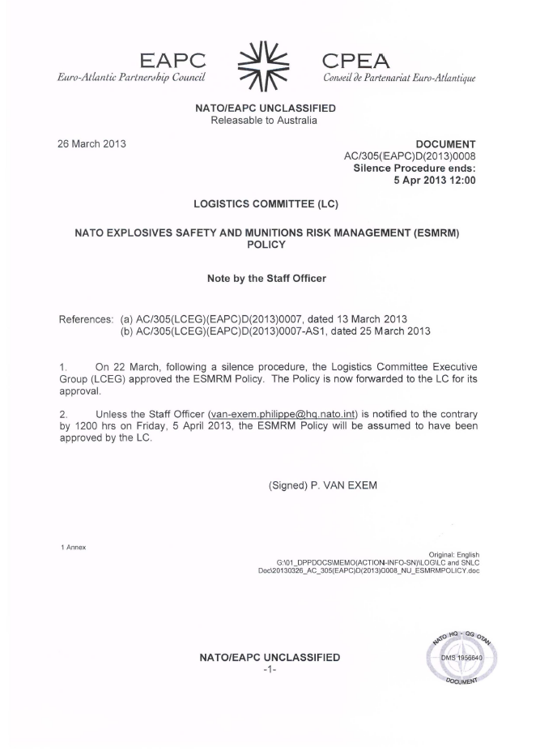
ESMRM Source Document
POLICY
NATO UNCLASSIFIED
Notes:
ESMRM Policy was approved by the Logistics Committee Executive Group (LCEG) in April 2013. Reference Document: AC/305(EAPC)D(2013)0008

Slide 10
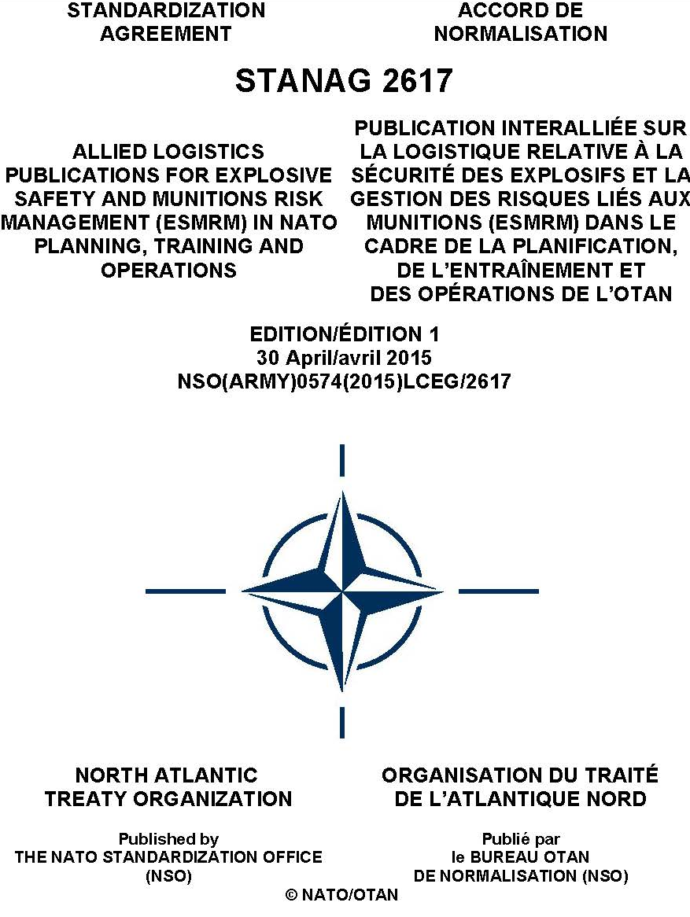
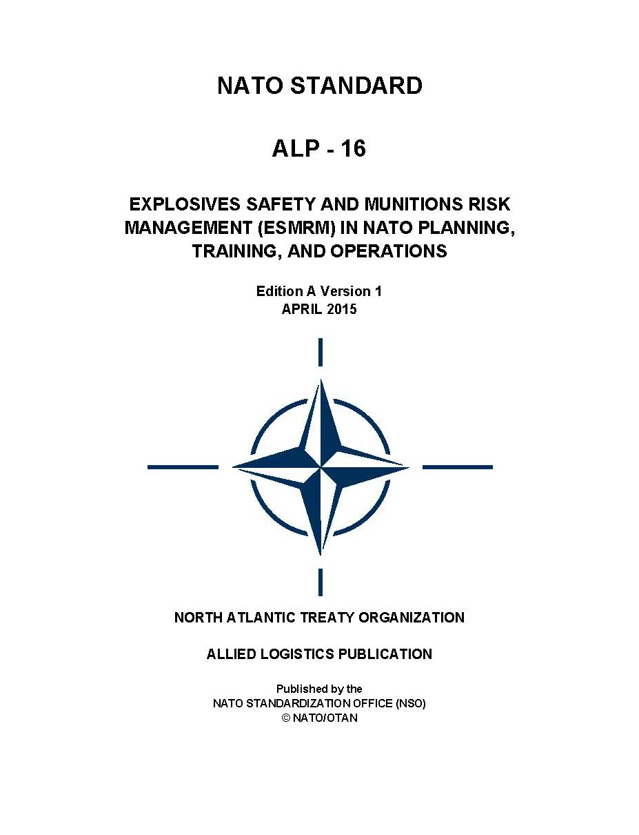
ESMRM Core Documents
STANAG
ALP
NATO UNCLASSIFIED
Notes:
Allied Logistic Publication (ALP)-16 establishes requirements for the NATO ESMRM process and identifies roles and responsibilities applicable to the NATO Operational Planning Process (OPP), the Operational Stages, and the Consumer Logistics Process across the full range of NATO military operations to include munitions-related contracted support.

Slide 11
ESMRM – What & Why
What
ESMRM is a systematic approach that integrates risk assessment into the planning and execution of all NATO activity with the goal of identifying potential consequences associated with munitions operations and presenting risk reduction alternatives and risk decision criteria for authorised decision makers. (ALP 16)
ESMRM allows NATO commanders to deliver operational effect at tolerable levels of explosives safety risk in order to positively contribute to mission success (ALP 16)
Notes:
Discussion:
Was a Risk Assessment conducted?
What Risk was involved with this operation?
Who was responsible for accepting the Risk?
What’s the Mission Impact?
What could have been done to mitigate the mishap?

Slide 12
ESMRM – What & Why
What
Risk assessment
Risk management
Process
Regulation
Notes:
Discussion:
Was a Risk Assessment conducted?
What Risk was involved with this operation?
Who was responsible for accepting the Risk?
What’s the Mission Impact?
What could have been done to mitigate the mishap?

Slide 13
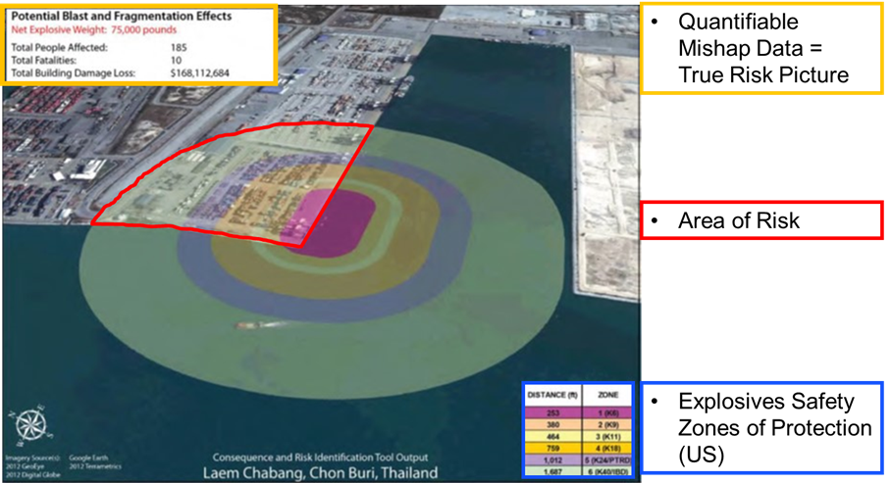
ESMRM – What and Why
Assessment and Management
- 75,000 lbs NEW /34,020 kg NEQ
- 185 personnel affected (port workers)
- Potential for 10 dead from a munitions mishap
- 168,112,684 USD / 94,415,868 EURO infrastructure damage
COAs
1. Utilize alternate port location to minimize exposures
2. Conduct ops at night (non-duty hrs) to reduce unrelated worker exposures
3. Offload munitions directly on trucks for immediate transport

Slide 14
ESMRM – What & Why
What
Risk assessment
Risk management
Process
Regulation
Notes:
Discussion:
Was a Risk Assessment conducted?
What Risk was involved with this operation?
Who was responsible for accepting the Risk?
What’s the Mission Impact?
What could have been done to mitigate the mishap?

Slide 15
ESMRM Process
Potential Mission Impact:
Munitions Safety issues identified during operations planning or execution - unintended explosive events, public safety, secondary hazards, distribution issues… ESMRM Assessment required
Develop Solutions:
Risk Analysis
Risk Reduction COAs developed
Commander’s risk decision
Solution in Place:
Apply mitigation
Manage mitigation
Ongoing Assessment……..
Using the ESMRM Process during mission planning and execution
directly contributes to Mission success

Slide 16
VIDEO – Port Scenario
Notes:
Port Scenario Video (3 min video) Set the Stage: This scenario is an example of what could happen if ESMRM is NOT considered at an operating location where munitions are involved.
Let’s watch the video and then we’ll have a discussion on ‘what could have been done differently’.

Slide 17
Video Discussion
Basic illustration of things can go wrong with munitions
Identifies the requirement for assessing risk
Demonstrates the need for SMEs
Unintended explosive event at Tactical Level could have Strategic implications
Notes:
Discussion:
Was a Risk Assessment conducted?
What Risk was involved with this operation?
Who was responsible for accepting the Risk?
What’s the Mission Impact?
What could have been done to mitigate the mishap?

Slide 18
ESMRM – What & Why
What
Risk assessment
Risk management
Process
Regulation
Provided through ALP 16
Notes:
Discussion:
Was a Risk Assessment conducted?
What Risk was involved with this operation?
Who was responsible for accepting the Risk?
What’s the Mission Impact?
What could have been done to mitigate the mishap?

Slide 19
ESMRM – What & Why
Why
AASTP-5, “NATO Guidelines for the Storage, Maintenance and Transport of Ammunition on Deployed Missions or Operations
Afghan campaign highlighted critical safety issues in explosives safety and a Capability Gap in explosives safety risk management
4000 Kg
Notes:
Discussion:
Was a Risk Assessment conducted?
What Risk was involved with this operation?
Who was responsible for accepting the Risk?
What’s the Mission Impact?
What could have been done to mitigate the mishap?

Slide 20
ESMRM – What & Why
Why
Cold War
Authorised
Munitions Infrastructure
Pre-positioned stock
Regional forces
Regional TREX
Planned responses
Risk Management
Post RAP
Strategic shock
360 focus
Greater reach
Rotational forces
Notes:
Much has changed since the cold war, the peace dividend has seen nations drawing down their storage capacities and lodger Armies such as the British Army of the Rhine, returning to their own nations. SACEUR’s AOR is much bigger, with less infrastructure dedicated to ES. The threat isn’t just from the East, we need to react swiftly with forces that are strewn across EU and Continental US. We re-plan every year and have no standing authority to make ES decisions

Slide 21
ES – Responsibility
Quotes from the current AJP 4
Joint task force J4 staff - coordinate and staff explosives safety and munitions risk management (ESMRM) assessments in support of COM JTF’s risk decision
Logistic Risk and Opportunities - Explosives safety and risk management assessments are conducted and that all munitions-related risks are identified to COM JTF
Storage area command and control. POL storage areas may come within COM JLSG’s chain of command. However, whilst ammunition storage facility could be under COM JLSG’s control, the management of munitions is more likely to be undertaken on a national or multinational basis
Supply. POL and A&E management will normally be accomplished by means of purpose-built storage areas and the employment of specialist POL and A&E staff.
Supply. Within the JTF headquarters (HQ) and/or JLSG HQ, the staff will ensure that correct supply procedures are followed including; accounting of stocks; visibility of available assets to support operations; maintenance of safety; and quality of product
Notes:
Discussion:
Was a Risk Assessment conducted?
What Risk was involved with this operation?
Who was responsible for accepting the Risk?
What’s the Mission Impact?
What could have been done to mitigate the mishap?

Slide 22
ES – Responsibility
Quotes from the current AJP 4
Joint task force J4 staff - coordinate and staff explosives safety and munitions risk management (ESMRM) assessments in support of COM JTF’s risk decision
Logistic Risk and Opportunities - Explosives safety and risk management assessments are conducted and that all munitions-related risks are identified to COM JTF
Storage area command and control. POL storage areas may come within COM JLSG’s chain of command. However, whilst ammunition storage facility could be under COM JLSG’s control, the management of munitions is more likely to be undertaken on a national or multinational basis
Supply. POL and A&E management will normally be accomplished by means of purpose-built storage areas and the employment of specialist POL and A&E staff.
Supply. Within the JTF headquarters (HQ) and/or JLSG HQ, the staff will ensure that correct supply procedures are followed including; accounting of stocks; visibility of available assets to support operations; maintenance of safety; and quality of product
UNCLEAR Responsibility for ES
Notes:
Discussion:
Was a Risk Assessment conducted?
What Risk was involved with this operation?
Who was responsible for accepting the Risk?
What’s the Mission Impact?
What could have been done to mitigate the mishap?

Slide 23
ES – Responsibility
Quotes from the current AJP 4
Joint task force J4 staff - coordinate and staff explosives safety and munitions risk management (ESMRM) assessments in support of COM JTF’s risk decision
Logistic Risk and Opportunities - Explosives safety and risk management assessments are conducted and that all munitions-related risks are identified to COM JTF
Storage area command and control. POL storage areas may come within COM JLSG’s chain of command. However, whilst ammunition storage facility could be under COM JLSG’s control, the management of munitions is more likely to be undertaken on a national or multinational basis
Supply. POL and A&E management will normally be accomplished by means of purpose-built storage areas and the employment of specialist POL and A&E staff.
Supply. Within the JTF headquarters (HQ) and/or JLSG HQ, the staff will ensure that correct supply procedures are followed including; accounting of stocks; visibility of available assets to support operations; maintenance of safety; and quality of product
MC 319/4
AJP 4 & AJP 4.1 Sustainment
- Ammo Chapter
ALP 16 (Dec 23)
UNCLEAR Responsibility for ES
Notes:
Discussion:
Was a Risk Assessment conducted?
What Risk was involved with this operation?
Who was responsible for accepting the Risk?
What’s the Mission Impact?
What could have been done to mitigate the mishap?

Slide 24
Roles & Responsibilities
Strategic
SHAPE - Requirements authority, Strat Planning – delegation, HN interface, authority brokerage, requirement statement, CRMs
Operational
JFCs - Planning phase - ES planning, delegation, CRM selection,
Execution phase – ES referral, assessment & maintenance
JSEC - ES within RbyF, 5SA to E, ACO/TCN/TN/HN sync
AOR ES functional management
Tactical
JLSGs – Establish and maintain ES in TLB, JLSN, sync ESMRM within AOR
CCs – Informing the requirement, delegation to Battle Space Owners (BSO)
BSOs – ESMRM application, assessment & mitigation
Nations – Support establishment of ESMRM, authority endorsement, CRMs

Slide 25
ESMRM Authority
Explosive safety risk decisions are national responsibilities, unless authority is given to appropriate NATO commanders by the host or transit nation. The authority to apply this ALP and subsequently make risk decisions must be confirmed by the Operations or Exercise Commander and endorsed by the appropriate host or transit nation.
ALP-16 Chapter 1 Para 1.2.3. NATO ESMRM Policy
NATO UNCLASSIFIED

Slide 26
ESMRM Authority
Authority
The authority to apply ESMRM principles to any type of military activity must be granted
No standing agreement or authority to apply the ESMRM process and take explosives safety risk decisions exists for NATO military activity within host nations
Each NATO sovereign nation holds the authority and must be consulted in order for it to be granted to NATO commanders
SACEUR’s authority to conduct NATO military activity in NATO host nations is governed through the endorsement of specific plans and directives by the NAC and at times by individual HNs
It is therefore imperative that authority is brokered during planning and the plan
illustrates what authorities are granted and at what point of the military activity
NATO UNCLASSIFIED

Slide 27
ESMRM Authority
Authority
NATO
National/NATO
Authority
National
Peace
Crisis
Conflict
NATO UNCLASSIFIED

Slide 28
ESMRM Authority
Authority
NATO
National/NATO
Authority
Speed of relevance
National
Peace
Crisis
Conflict
NATO UNCLASSIFIED

Slide 29
ESMRM Authority
Authority
NATO
National/NATO
Authority
Speed of relevance
National
Peace
Crisis
Conflict
NATO UNCLASSIFIED

Slide 30
ESMRM Authority
Means to gain authority:
HN consultation & agreement
NAC approved plan (HN agreed)
MOU/TA
Bi Lat
Non permissive environment
NAC approved plan
Notes:
There is no standing authority for NATO forces to take ES risk decisions on a HNs sovereign territory. The authority must be brokered and agreed during the planning phase in order to empower NATO commanders to take action and make decisions iaw ALP 16
In a none permissive environment, the NAC must decide what powers Allied forces can exercise across a broad spectrum od activity including ES

Slide 31
ESMRM Dynamic Application
Battle Space Owners (BSOs) at Div level must be able to make dynamic ES decisions in order to maintain manoeuvre Ops
Conflict paradigm
Must be authorised (OPLAN)
JLSG oversight through R2
Referral Process, where risk unacceptable/mitigation unachievable

Slide 32
ESMRM Referral
Where Battle Space Owners (BSOs) can’t apply appropriate mitigation:
Resource – Engineer, materiel, personnel
Real estate – locn change, space
FP/Sy/AD – overall site security
HN influence – Inhabited Bldg, PTR, 2ndry hazards…
Mission change
Risk Decision must be referred through the CoC
Notes:
There is no standing authority for NATO forces to take ES risk decisions on a HNs sovereign territory. The authority must be brokered and agreed during the planning phase in order to empower NATO commanders to take action and make decisions iaw ALP 16
In a none permissive environment, the NAC must decide what powers Allied forces can exercise across a broad spectrum od activity including ES

Slide 33
Risk Decision – Referral Process
Bde HQ
New Requirement?
Authority Exists?
(NAC & CoC)
Yes No
Organise use of Existing facility
Gain Authority or refer to CoC
No Yes
Conduct Risk Assessment
Mitigation Feasible and Achievable?
Refer to Div HQ
Co-ord usage with JLSG HQ
Refer to Corps HQ
No
Refer to LCC
Yes
Execute plan and mitigation measures
Refer to JTF
Each Level of the CoC must assess
feasibility and achievability of risk mitigation,
before referring to next level
Revise Mission
Refer to SHAPE
33
Notes:
In some circumstance a BSO at Div level may not be able to apply appropriate mitigation in order to reduce risk to the appropriate level, where this is the case it must be referred up the chain of command until the resource or authority is gained to be able to apply the mitigation or find an alternative solution

Slide 34
ESMRM - TREX
ESMRM within BiSC 75-003 – Collective Trg and Exercise Directive (proposed additions)
Where LIVEX is planned considerations must be made for appropriate Explosives and Munitions safety throughout the exercise to include storage, transport, handling and where required processing and disposal facilities
For LIVEX additional considerations must be made for risks to PS posed by the storage, handling, transportation, processing and disposal of Explosives and Munitions
Appropriate infrastructure and support to provide for explosives and munitions safety during storage, handling, transportation, processing and disposal.
The presence of Explosives and Munitions during a LIVEX presents inherent risk to personnel and property and requires due planning consideration
Notes:
There is no standing authority for NATO forces to take ES risk decisions on a HNs sovereign territory. The authority must be brokered and agreed during the planning phase in order to empower NATO commanders to take action and make decisions iaw ALP 16
In a none permissive environment, the NAC must decide what powers Allied forces can exercise across a broad spectrum od activity including ES

Slide 35
VIDEO – FOB Scenario
Notes:
FOB Raptor Scenario. (6 min video)

Slide 36
ESMRM Way Forward
Broker in planning - Authority, Infra, real estate, HNS
Use ESMRM to solve problems in planning and execution
Understand ALP 16 & NCS SOPs
Do not consider ES as a TCN problem – Plan for ES, include host nations
Ensure SME participation during planning (all levels)
Future Initiatives - CRMs, AJP 4.1, Bi-SC 75/3

Slide 37
ESMRM
Questions?

